Slide 2
[Severity 1] Injection
SQL Injection: This occurs when user controlled input is passed to SQL queries. As a result, an attacker can pass in SQL queries to manipulate the outcome of such queries.
Command Injection: This occurs when user input is passed to system commands. As a result, an attacker is able to execute arbitrary system commands on application servers
OS Command Injection:
Command Injection occurs when server-side code (like PHP) in a web application makes a system call on the hosting machine. It is a web vulnerability that allows an attacker to take advantage of that made system call to execute operating system commands on the server.
The worst thing they could do would be to spawn a reverse shell to become the user that the web server is running as. A simple ;nc -e /bin/bash is all that's needed and they own your server; some variants of netcat don't support the -e option. You can use a list of these reverse shells as an alternative.
https://github.com/swisskyrepo/PayloadsAllTheThings/blob/master/Methodology%20and%20Resources/Reverse%20Shell%20Cheatsheet.md

Slide 3
What is Active Command Injection?
Blind command injection occurs when the system command made to the server does not return the response to the user in the HTML document. Active command injection will return the response to the user. It can be made visible through several HTML elements.
lsb_release –a
ls /etc/motd
Cat /etc/passwd

Slide 4
[Severity 2] Broken Authentication
Authentication allows users to gain access to web applications by verifying their identities. The most common form of authentication is using a username and password mechanism. A user would enter these credentials, the server would verify them. If they are correct, the server would then provide the users’ browser with a session cookie. A session cookie is needed because web servers use HTTP(S) to communicate which is stateless. Attaching session cookies means that the server will know who is sending what data. The server can then keep track of users' actions.
If an attacker is able to find flaws in an authentication mechanism, they would then successfully gain access to other users’ accounts. This would allow the attacker to access sensitive data (depending on the purpose of the application). Some common flaws in authentication mechanisms include:
Brute force attacks: If a web application uses usernames and passwords, an attacker is able to launch brute force attacks that allow them to guess the username and passwords using multiple authentication attempts.
Use of weak credentials: web applications should set strong password policies. If applications allow users to set passwords such as ‘password1’ or common passwords, then an attacker is able to easily guess them and access user accounts. They can do this without brute forcing and without multiple attempts.
Weak Session Cookies: Session cookies are how the server keeps track of users. If session cookies contain predictable values, an attacker can set their own session cookies and access users’ accounts.

Slide 5
There can be various mitigation for broken authentication mechanisms depending on the exact flaw:
To avoid password guessing attacks, ensure the application enforces a strong password policy.
To avoid brute force attacks, ensure that the application enforces an automatic lockout after a certain number of attempts. This would prevent an attacker from launching more brute force attacks.
Implement Multi Factor Authentication - If a user has multiple methods of authentication, for example, using username and passwords and receiving a code on their mobile device, then it would be difficult for an attacker to get access to both credentials to get access to their account
Practical:
Let's understand this with the help of an example, say there is an existing user with the name admin and now we want to get access to their account so what we can do is try to re-register that username but with slight modification. We are going to enter " admin“{whitespace}(notice the space in the starting). Now when you enter that in the username field and enter other required information like email id or password and submit that data. It will actually register a new user but that user will have the same right as normal admin. That new user will also be able to see all the content presented under the user admin.

Slide 6
[Severity 3] Sensitive Data Exposure (Introduction)
When a webapp accidentally divulges/reveles sensitive data, we refer to it as "Sensitive Data Exposure". This is often data directly linked to customers (e.g. names, dates-of-birth, financial information, etc), but could also be more technical information, such as usernames and passwords. At more complex levels this often involves techniques such as a "Man in The Middle Attack", whereby the attacker would force user connections through a device which they control, then take advantage of weak encryption on any transmitted data to gain access to the intercepted information (if the data is even encrypted in the first place...). Of course, many examples are much simpler, and vulnerabilities can be found in web apps which can be exploited without any advanced networking knowledge. Indeed, in some cases, the sensitive data can be found directly on the webserver itself...
Supporting Material 1
In a production environment it is common to see databases set up on dedicated servers, running a database service such as MySQL or MariaDB; however, databases can also be stored as files. These databases are referred to as "flat-file" databases, as they are stored as a single file on the computer
The most common (and simplest) format of flat-file database is an sqlite database. These can be interacted with in most programming languages, and have a dedicated client for querying them on the command line. This client is called "sqlite3", and is installed by default on Kali.

Slide 7



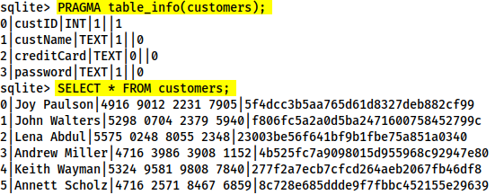
Download it
To access it we use: sqlite3 <database-name>
From here we can see the tables in the database by using the .tables command:
At this point we can dump all of the data from the table, but we won't necessarily know what each column means unless we look at the table information. First let's use PRAGMA table_info(customers); to see the table information, then we'll use SELECT * FROM customers; to dump the information from the table

Slide 8
(Supporting Material 2)(cracking hash):
https://crackstation.net/
[Severity 4] XML External Entity
An XML External Entity (XXE) attack is a vulnerability that abuses features of XML parsers/data. It often allows an attacker to interact with any backend or external systems that the application itself can access and can allow the attacker to read the file on that system. They can also cause Denial of Service (DoS) attack or could use XXE to perform Server-Side Request Forgery (SSRF) inducing the web application to make requests to other applications. XXE may even enable port scanning and lead to remote code execution.
There are two types of XXE attacks: in-band and out-of-band (OOB-XXE) 1) An in-band XXE attack is the one in which the attacker can receive an immediate response to the XXE payload.
2) out-of-band XXE attacks (also called blind XXE), there is no immediate response from the web application and attacker has to reflect the output of their XXE payload to some other file or their own server.
Severity 4 XML External Entity - eXtensible Markup Language
XML (eXtensible Markup Language) is a markup language that defines a set of rules for encoding documents in a format that is both human-readable and machine-readable. It is a markup language used for storing and transporting data.

Slide 9
Why we use XML?
1. XML is platform-independent and programming language independent, thus it can be used on any system and supports the technology change when that happens. 2. The data stored and transported using XML can be changed at any point in time without affecting the data presentation. 3. XML allows validation using DTD and Schema. This validation ensures that the XML document is free from any syntax error. 4. XML simplifies data sharing between various systems because of its platform-independent nature. XML data doesn’t require any conversion when transferred between different systems.

Slide 10
Every XML document mostly starts with what is known as XML Prolog.
Above the line is called XML prolog and it specifies the XML version and the encoding used in the XML document. This line is not compulsory to use but it is considered a `good practice` to put that line in all your XML documents.
Every XML document must contain a `ROOT` element. For example:
In the above example the <mail> is the ROOT element of that document and <to>, <from>, <subject>, <text> are the children elements. If the XML document doesn't have any root element then it would be consideredwrong or invalid XML doc.
Another thing to remember is that XML is a case sensitive language. If a tag starts like <to> then it has to end by </to> and not by something like </To>(notice the capitalization of T)
Like HTML we can use attributes in XML too. The syntax for having attributes is also very similar to HTML. For example:
<text category = "message">You need to learn about XXE</text>
In the above example category is the attribute name and message is the attribute value.
<?xml version="1.0" encoding="UTF-8"?>
<?xml version="1.0" encoding="UTF-8"?>
<mail>
<to>falcon</to>
<from>feast</from>
<subject>About XXE</subject>
<text>Teach about XXE</text>
</mail>

Slide 11
XML External Entity – DTD
DTD stands for Document Type Definition. A DTD defines the structure and the legal elements and attributes of an XML document.
Now we can use this DTD to validate the information of some XML document and make sure that the XML file conforms to the rules of that DTD.
Ex: Below is given an XML document that uses note.dtd
<?xml version="1.0" encoding="UTF-8"?>
<!DOCTYPE note SYSTEM "note.dtd">
<note>
<to>falcon</to>
<from>feast</from>
<heading>hacking</heading>
<body>XXE attack</body>
</note>
So now let's understand how that DTD validates the XML. Here's what all those terms used in note.dtd mean
!DOCTYPE note - Defines a root element of the document named note
!ELEMENT note - Defines that the note element must contain the elements: "to, from, heading, body"
!ELEMENT to - Defines the to element to be of type "#PCDATA"
!ELEMENT from - Defines the from element to be of type "#PCDATA"
!ELEMENT heading - Defines the heading element to be of type "#PCDATA"
!ELEMENT body - Defines the body element to be of type "#PCDATA"
NOTE: #PCDATA means parseable character data.
<!DOCTYPE note [ <!ELEMENT note (to,from,heading,body)> <!ELEMENT to (#PCDATA)> <!ELEMENT from (#PCDATA)> <!ELEMENT heading (#PCDATA)> <!ELEMENT body (#PCDATA)> ]>

Slide 12
XML External Entity - XXE Payload
As we can see we are defining a ENTITY called name and assigning it a value feast. Later we are using that ENTITY in our code.
Here again, we are defining an ENTITY with the name read but the difference is that we are setting it value to `SYSTEM` and path of the file.
If we use this payload then a website vulnerable to XXE(normally) would display the content of the file /etc/passwd.
<!DOCTYPE replace [<!ENTITY name "feast"> ]> <userInfo> <firstName>falcon</firstName> <lastName>&name;</lastName> </userInfo>
<?xml version="1.0"?> <!DOCTYPE root [<!ENTITY read SYSTEM 'file:///etc/passwd'>]> <root>&read;</root>

Slide 13
[Severity 5] Broken Access Control
Websites have pages that are protected from regular visitors, for example only the site's admin user should be able to access a page to manage other users. If a website visitor is able to access the protected page/pages that they are not authorised to view, the access controls are broken.
OWASP have a listed a few attack scenarios demonstrating access control weaknesses:
Scenario #1: The application uses unverified data in a SQL call that is accessing account information:
pstmt.setString(1, request.getParameter("acct"));
ResultSet results = pstmt.executeQuery( );
An attacker simply modifies the ‘acct’ parameter in the browser to send whatever account number they want. If not properly verified, the attacker can access any user’s account.
http://example.com/app/accountInfo?acct=notmyacct

Slide 14
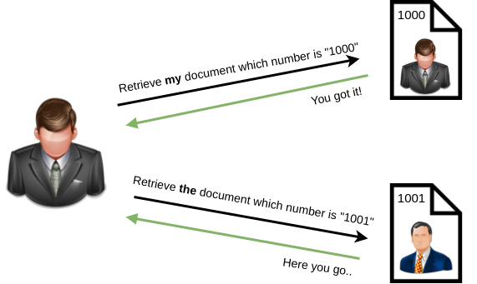
Scenario #2: An attacker simply force browses to target URLs. Admin rights are required for access to the admin page.
http://example.com/app/getappInfo
http://example.com/app/admin_getappInfo
If an unauthenticated user can access either page, it’s a flaw. If a non-admin can access the admin page, this is a flaw (reference to scenarios). https://owasp.org/www-project-top-ten/2017/A5_2017-Broken_Access_Control.html
To put simply, broken access control allows attackers to bypass authorization which can allow them to view sensitive data or perform tasks as if they were a privileged user.
[Severity 5] Broken Access Control (IDOR Challenge)
IDOR, or Insecure Direct Object Reference, is the act of exploiting a misconfiguration in the way user input is handled, to access resources you wouldn't ordinarily be able to access. IDOR is a type of access control vulnerability.

Slide 15
[Severity 6] Security Misconfiguration
Security Misconfiguration
Security Misconfigurations are distinct from the other Top 10 vulnerabilities, because they occur when security could have been configured properly but was not.
Security misconfigurations include:
Poorly configured permissions on cloud services, like S3 buckets
Having unnecessary features enabled, like services, pages, accounts or privileges
Default accounts with unchanged passwords
Error messages that are overly detailed and allow an attacker to find out more about the system
Not using HTTP security headers, or revealing too much detail in the Server: HTTP header(https://owasp.org/www-project-secure-headers/)
This vulnerability can often lead to more vulnerabilities, such as default credentials giving you access to sensitive data, XXE or command injection on admin pages.
For more info, I recommend having a look at the OWASP top 10 entry for Security Misconfiguration(https://owasp.org/www-project-top-ten/2017/A6_2017-Security_Misconfiguration.html)

Slide 16
[Severity 7] Cross-site Scripting:
Cross-site scripting, also known as XSS is a security vulnerability typically found in web applications. It’s a type of injection which can allow an attacker to execute malicious scripts and have it execute on a victim’s machine. A web application is vulnerable to XSS if it uses unsanitized user input. XSS is possible in Javascript, VBScript, Flash and CSS. There are three main types of cross-site scripting:
Stored XSS - the most dangerous type of XSS. This is where a malicious string originates from the website’s database. This often happens when a website allows user input that is not sanitised (remove the "bad parts" of a users input) when inserted into the database.
Reflected XSS - the malicious payload is part of the victims request to the website. The website includes this payload in response back to the user. To summarise, an attacker needs to trick a victim into clicking a URL to execute their malicious payload.
DOM-Based XSS - DOM stands for Document Object Model and is a programming interface for HTML and XML documents. It represents the page so that programs can change the document structure, style and content. A web page is a document and this document can be either displayed in the browser window or as the HTML source

Slide 17
XSS Payloads
Remember, cross-site scripting is a vulnerability that can be exploited to execute malicious Javascript on a victim’s machine. Check out some common payloads types used:
Popup's (<script>alert(“Hello World”)</script>) - Creates a Hello World message popup on a users browser.
Writing HTML (document.write) - Override the website's HTML to add your own (essentially defacing the entire page).
XSS Keylogger (http://www.xss-payloads.com/payloads/scripts/simplekeylogger.js.html) - You can log all keystrokes of a user, capturing their password and other sensitive information they type into the webpage.
Port scanning (http://www.xss-payloads.com/payloads/scripts/portscanapi.js.html) - A mini local port scanner (more information on this is covered in the TryHackMe XSS room).
XSS-Payloads.com (http://www.xss-payloads.com/) is a website that has XSS related Payloads, Tools, Documentation and more. You can download XSS payloads that take snapshots from a webcam or even get a more capable port and network scanner
In javascript to show host ip : <script>alert(window.location.hostname)</script> Change "XSS Playground" to "I am a hacker" by adding a comment and using Javascript.
<script>document.querySelector('#thm-title').textContent = 'I am a hacker'</script
Test xss top 10 : https://www.youtube.com/watch?v=9NIIbVnB_PI&list=PLBCWFgREB971Ksst2rp3fSnGvGD_ms_dz&index=7

Slide 18
[Severity 8] Insecure Deserialization
"Insecure Deserialization is a vulnerability which occurs when untrusted data is used to abuse the logic of an application“
This definition is still quite broad to say the least. Simply, insecure deserialization is replacing data processed by an application with malicious code; allowing anything from DoS (Denial of Service) to RCE (Remote Code Execution) that the attacker can use to gain a foothold in a pentesting scenario.
What's Vulnerable?
E-Commerce Sites - Forums - API's - Application Runtimes (Tomcat, Jenkins, Jboss, etc)
[Severity 8] Insecure Deserialization – Objects
Simply, objects allow you to create similar lines of code without having to do the leg-work of writing the same lines of code again.
[Severity 8] Insecure Deserialization – Deserialization
Serialisation is the process of converting objects used in programming into simpler, compatible formatting for transmitting between systems or networks for further processing or storage.
Alternatively, deserialisation is the reverse of this; converting serialised information into their complex form - an object that the application will understand.

Slide 19
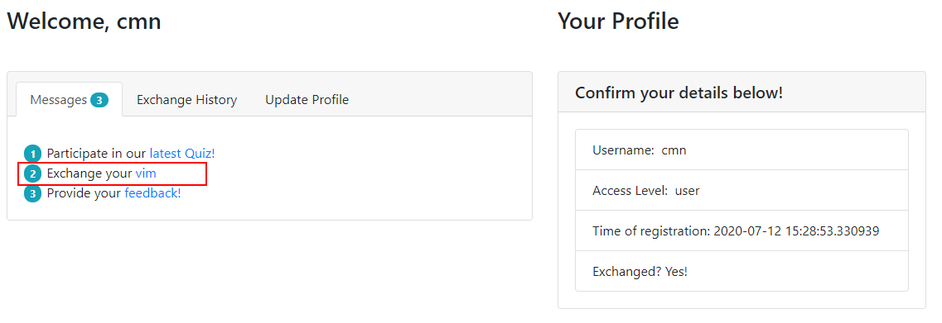
[Severity 8] Insecure Deserialization – Cookies
Ah yes, the origin of many memes. Cookies are an essential tool for modern websites to function. Tiny pieces of data, these are created by a website and stored on the user's computer. Websites use these cookies to store user-specific behaviours like items in their shopping cart or session IDs.
!st create a account…. Then try exploit……
Right-Click the Page and press "Inspect Element". Navigate to the "Storage" tab
You can change cookie value userType = user -→ admin
[Severity 8] Insecure Deserialization - Code Execution

Slide 20
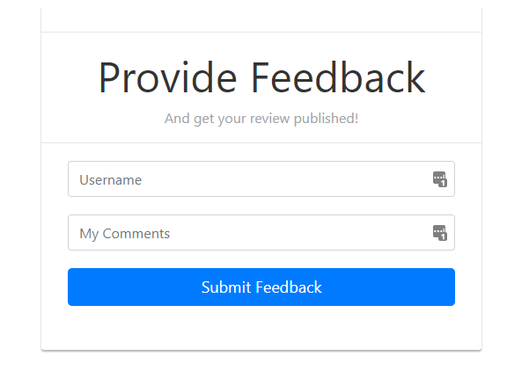

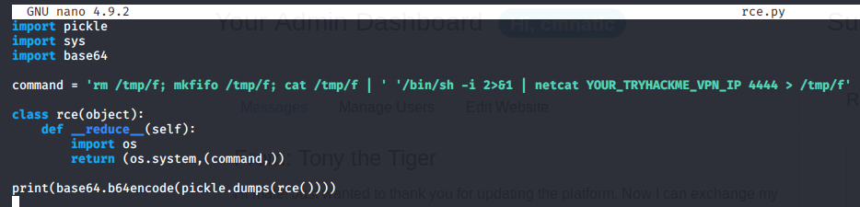
Once you have done this, left-click on the URL in "Provide your feedback!" where you will be direct to page like so:
The Exploit:
If a user was to enter their feedback, the data will get encoded and sent to the Flask application (presumably for storage within a database for example). However, the application assumes that any data encoded is trustworthy. But we're hackers. You can only trust us as far as you can fling us

Slide 21
Copy and paste everything in-between the two speech marks ('DATA'). In my case, I will copy and paste:
Paste this into the "encodedPayload" cookie in your browser:

Slide 22
[Severity 9] Components With Known Vulnerabilities – Intro
[Severity 10] Insufficient Logging and Monitoring
When web applications are set up, every action performed by the user should be logged. Logging is important because in the event of an incident, the attackers actions can be traced. Once their actions are traced, their risk and impact can be determined
The information stored in logs should include:
HTTP status codes
Time Stamps
Usernames
API endpoints/page locations
IP addresse

